Slide 1
C
Flow Control

Slide 2
C
Flow chart

Slide 3
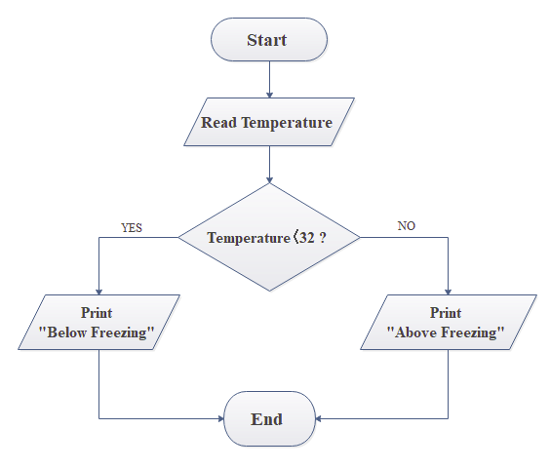

Slide 4
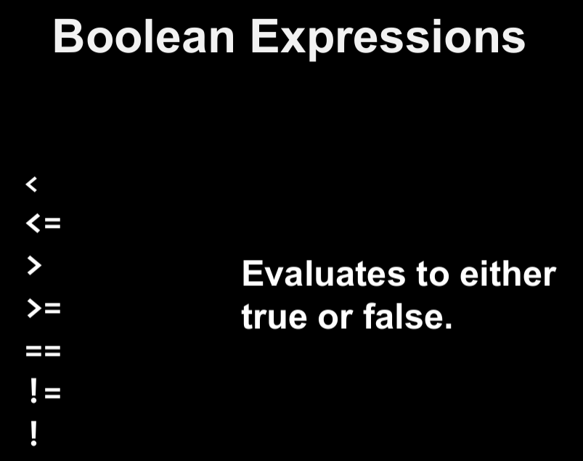
REMINDER
C
Flow chart

Slide 5
C
Conditions

Slide 6
if statement
if (test expression)
{
// statements to be executed if ture
}
// statements to be executed if false
The if statement evaluates the test expression inside the parenthesis ()

Slide 7
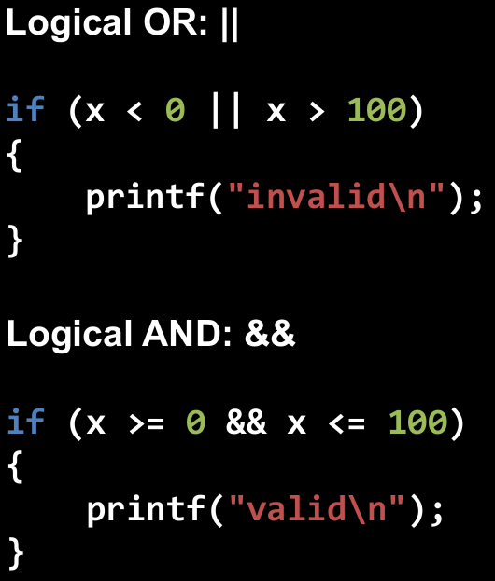
if statement
counter = counter + 1
The if statement evaluates the test expression inside the parenthesis ()

Slide 8
if statement
Example 2.1
The if statement evaluates the test expression inside the parenthesis ()

Slide 9


Slide 10
if (test expression) {
// statements to be executed if the test expression is true
}
else {
// statements to be executed if the test expression is false
}
if .. else statement
The if statement may have an optional else block.

Slide 11
if .. else statement
Example 2.2
The if statement may have an optional else block.

Slide 13
if (test expression1)
{
// statement(s)
}
else if(test expression2)
{
// statement(s)
}
else if (test expression3)
{
// statement(s)
}
else
{
// statement(s)
}
C if...else Ladder
The if...else ladder allows you to check between multiple test expressions and execute different statements.

Slide 14
C if...else Ladder
Example 2.3
The if...else ladder allows you to check between multiple test expressions and execute different statements.

Slide 16
if (test expression1)
{
// statement(s)
}
else if(test expression2)
{
// statement(s)
}
else if (test expression3)
{
// statement(s)
}
else
{
// statement(s)
}
Nested if...else
we will use a nested if...else statement to solve this problem.

Slide 17
Nested if...else
Example 2.4
we will use a nested if...else statement to solve this problem.

Slide 18
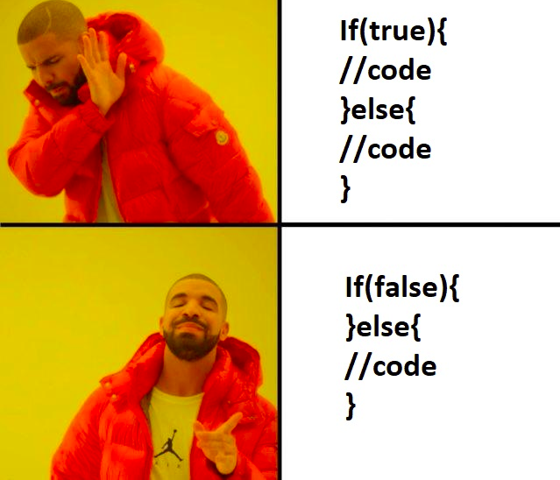
CONDITIONS
int counter = 0;
RANDOM MEME

Slide 19
Questions?

Slide 20
*Fact*
Do you know who’s Ada Lovelace?

Slide 21


Slide 22
YOU CAN DO IT!
Build a simple calculator that can
Scan 2 float numbers from user.
Scan an operator from user as character (+,-,*,/)
Do operation based on operator.
print the result to user, formatted with 3 numbers after decimal point (right).

Slide 23
C
Loops

Slide 24
C
for Loop

Slide 25
for Loop
for (initialization; test; update)
{
// statements inside the body of loop
}
The syntax of the for loop is:

Slide 26
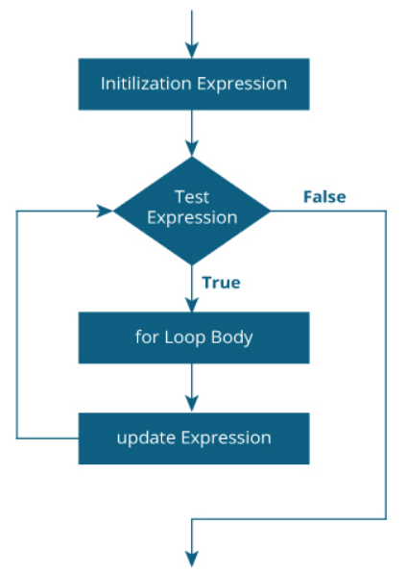

Slide 27
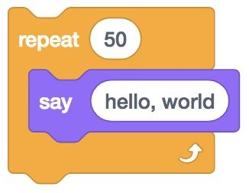

Slide 28
for

Slide 29
for
{
}

Slide 30
for
{
printf("hello, world\n");
}

Slide 31
for ( )
{
printf("hello, world\n");
}

Slide 32
for (int i = 0; )
{
printf("hello, world\n");
}

Slide 33
for (int i = 0; i < 50; )
{
printf("hello, world\n");
}

Slide 34
for (int i = 0; i < 50; i++)
{
printf("hello, world\n");
}

Slide 35
for (int i = 0; i < 50; i++)
{
printf("hello, world\n");
}

Slide 36
for (int i = 0; i < 50; i++)
{
printf("hello, world\n");
}

Slide 37
for (int i = 0; i < 50; i++)
{
printf("hello, world\n");
}

Slide 38
for (int i = 0; i < 50; i++)
{
printf("hello, world\n");
}

Slide 39
for (int i = 0; i < 50; i++)
{
printf("hello, world\n");
}

Slide 40
for (int i = 0; i < 50; i++)
{
printf("hello, world\n");
}

Slide 41
for (int i = 0; i < 50; i++)
{
printf("hello, world\n");
}

Slide 42
for (int i = 0; i < 50; i++)
{
printf("hello, world\n");
}

Slide 43
for (int i = 0; i < 50; i++)
{
printf("hello, world\n");
}

Slide 44
for (int i = 0; i < 50; i++)
{
printf("hello, world\n");
}

Slide 45
for (int i = 0; i < 50; i++)
{
printf("hello, world\n");
}

Slide 46
for (int i = 0; i < 50; i++)
{
printf("hello, world\n");
}

Slide 47
Nested if...else
Example 2.5
we will use a nested if...else statement to solve this problem.

Slide 48
C
while Loop

Slide 49
while Loops
while (testExpression)
{
// statements inside the body of the loop
}
The syntax of the while loop is:

Slide 50
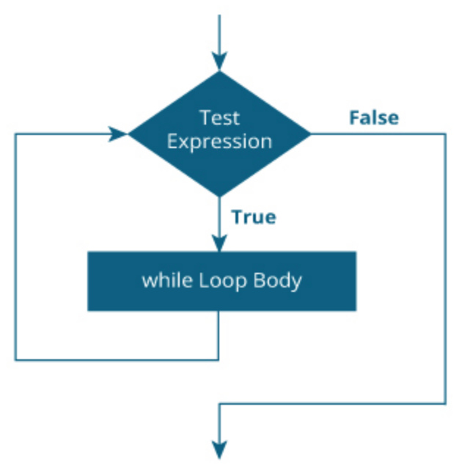

Slide 51
while Loops
Example 2.6
The syntax of the while loop is:

Slide 53
Questions?

Slide 54
*Fact*
Do you know who’s Fred Cohen?

Slide 55
C
continue, break

Slide 56
C
continue

Slide 57
continue
continue;
The continue statement skips the current iteration of the loop and continues with the next iteration.

Slide 58
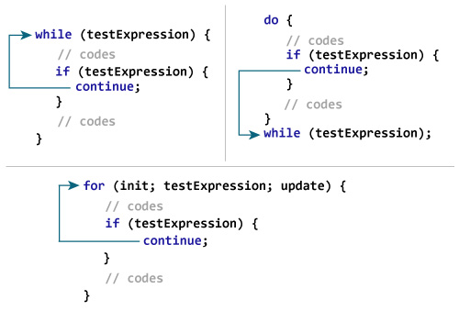

Slide 59
continue
Example 2.8
The continue statement skips the current iteration of the loop and continues with the next iteration.

Slide 60
C
break

Slide 61
break
break;
The break statement ends the loop immediately when it is encountered.

Slide 62
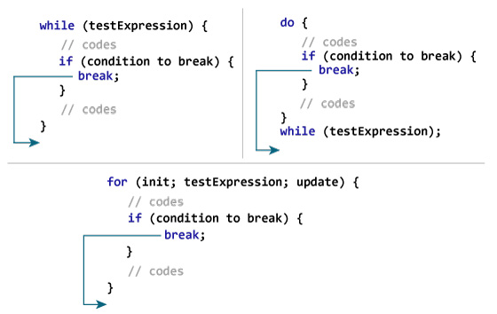

Slide 63
break
Example 2.9
The break statement ends the loop immediately when it is encountered.

Slide 64
C
switch

Slide 65
switch (expression)
​{
case constant1:
// statements
break;
case constant2:
// statements
break;
.
.
.
default:
// default statements
}
switch
The switch statement allows us to execute one code block among many alternatives.

Slide 66
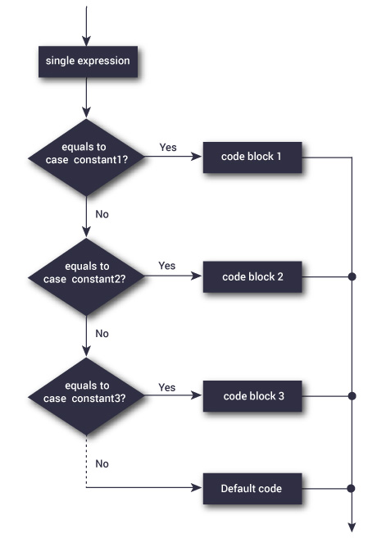

Slide 67
switch
Example 2.10
The switch statement allows us to execute one code block among many alternatives.

Slide 69
YOU CAN DO IT!
Display Fibonacci series.
Count number of digits of an integer.
C Program to Display Factors of a Number

